Slide 1


Celebrating Excellence: 10 Best Works by Women from PEN Centers
A curated collection showcasing outstanding literary achievements by women writers recognized by PEN Centers worldwide. Each work represents a unique voice contributing to global literature and the advancement of free expression.

Slide 2
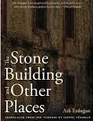
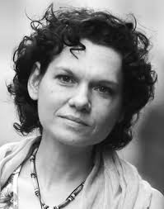
The Stone Building and Other Stories
Aslı Erdoğan
Turkish writer and human rights activist known for her poignant narratives on exile and freedom. Erdoğan's work has been translated into more than twenty languages, earning her international recognition for her unflinching examination of state violence.
Link to bio:
This powerful collection explores themes of displacement and resilience through intimate stories. Each narrative illuminates the human condition in the face of political oppression and exile. Link:
ISBN: 978-1948226460 Publisher: Archipelago Books
Availability: Available worldwide in print and digital formats

Slide 3

Contact & Further Information
PEN Center Contact
PEN Austria
Bankgasse 8
1010- Vienna
Austria
Email: info@penclub.at
Follow Us
Website: www.penclub.atFollow us on social media for updates on women writers and literary events.Explore more award-winning works and support free expression worldwide.
Join our community of readers and writers committed to celebrating diverse voices and defending the freedom to write. Contact your local PEN center to learn more about upcoming events and initiatives supporting women in literature.

